Slide 1
Does Mercury Retrograde have any effect on S&P 500 volatility?

Slide 2
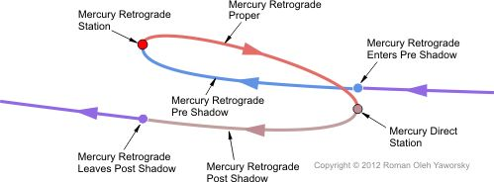
What is the Project About?
Mercury retrograde is an illusion of the planet moving east to west, when viewed from Earth, due to Mercury's orbit being about 4 times shorter than the Earth orbit. This occurs for about 3 weeks, 3-4 times a year. Astrologers put great importance on planets' retrograde cycles as they perceive that the area of human life "governed" by that planet will experience reversals and setbacks. Given the assumed negative effect of Mercury retrograde on markets, many investors stay away during these periods.
Astrologers define several stages for this planetary transit, as explained on the diagram from astrologymiami.com
According to financial astrologers, both retrograde and direct stations are characterised by high market volatility while the actual retrograde period usually results in the market correction.
This project will attempt to confirm this hypothesis by analyzing changes in S&P 500 values during various cycles of Mercury retrograde.

Slide 3
What data was used for the project?
The data for this project came from 4 sources:
a) Historical S&P 500 data from finance.yahoo.com has been used as a base
b) Mercury Retrograde calendar from astrologymiami.com has been used to assign Mercury Retrograde Degree to each date in S&P 500 data.
c) FOMC meetings calendar from federalreserve.gov has been used to assign Federal Reserve Conference to each date. This variable is used as a control variable since these meetings are expected to have an effect on the market.
d) Historical VIX (S&P 500 volatility index) from finance.yahoo.com has been added to the base dataset joining on the Date field
The following variables were added to S&P 500 and VIX data for each Date:
1. SP500_HighLow_Delta and VIX_HighLow_Delta, calculated as the difference between the date's High and Low values
2. SP500_HighLow_Delta_Percent and VIX_HighLow_Delta_Percent, calculated as the percentage of High/Low delta over the Low value
3. SP500_OpenClose_Delta and VIX_OpenClose_Delta, calculated as the difference between the date's Open and the previous date's Close
4. SP500_OpenClose_Delta_Percent and VIX_OpenClose_Delta_Percent, calculated as the perentage of Open/Close delta over the Close value
5. SP500_DeltaPercent_Combined and VIX_DeltaPErcent_Combined, calculated as the sum of absolute values of HighLow and OpenClose percentages.
Given that S&P 500 data is only available when the market is open, while Mercury retrograde degree changes may occur on weekends and holidays, the missing date records were added, imputing the S&P 500 variables with the averages of the two records, between which they were inserted.
Only dates fro May 5 2011 or later were included in the project, based on the earliest available Mercury Retrograde date.

Slide 4
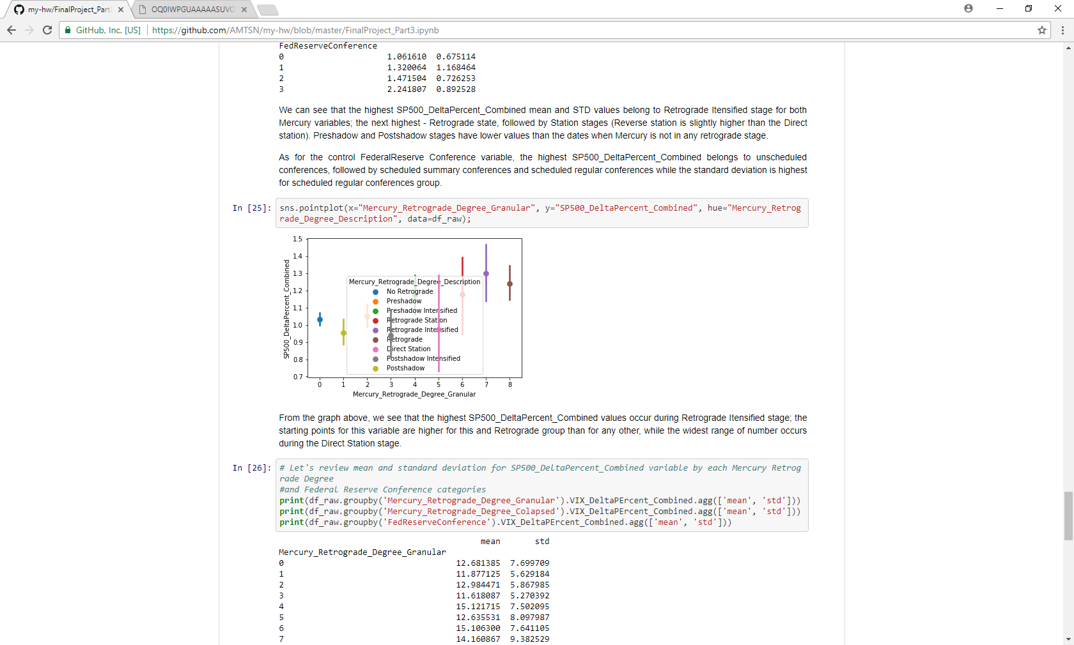
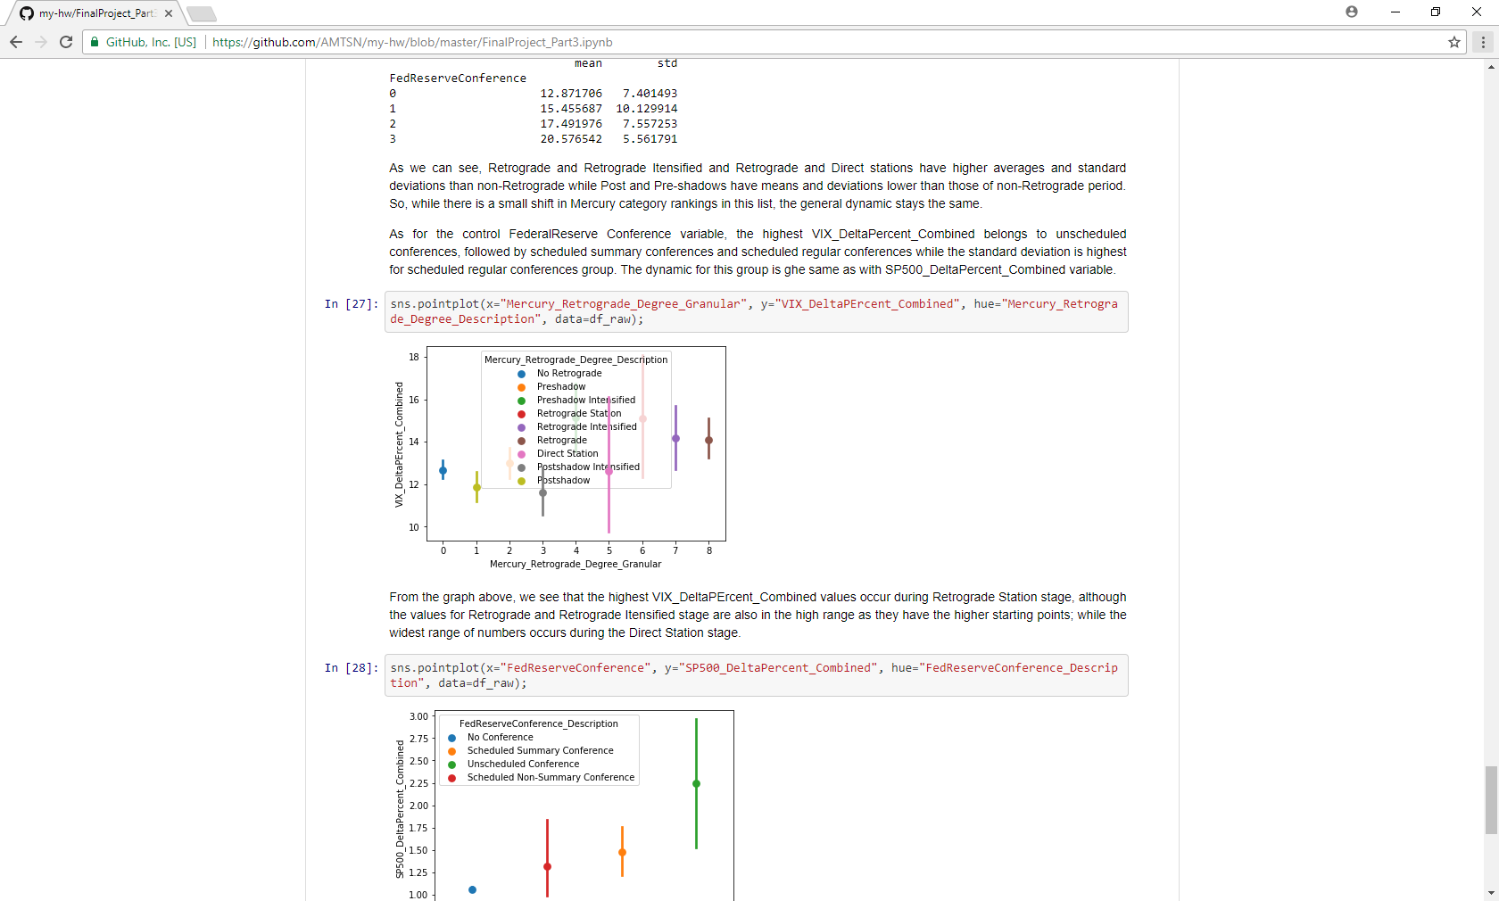
What did data analysis show?
The correlation between Mercury_Retrograde_Degree_Colapsed, Mercury_Retrograde_Degree_Granular, FedReserveConference and SP500_DeltaPercent_Combined or VIX_DeltaPErcent_Combined is pretty low. In fact, Mercury Retrograde Degree and FedReserveConference do not have high correlation to any of the S&P 500 variables in the dataset. However, their correlations to S&P 500 delta and delta percentage variables, as well as VIX_DeltaPErcent_Combined are among the highest for these variables.
The graphs did show that the highest SP500_DeltaPercent_Combined values occur during Retrograde Intensified stage; the starting points for this variable are higher for this and Retrograde group than for any other, while the widest range of numbers occurs during the Direct Station stage.
Overall, the mathematical exploration of the dataset indicated that S&P 500 data has a dynamic for larger movement (percentage-wise) between Open and previous days' Close, as well as the day's Low and High during the time between Mercury Retrograde and Direct Station dates.

Slide 5
What did the modeling stage reveal?
Mercury_Retrograde_Degree_Granular
Low R-squared values in linear regression models indicated that the relationship between Mercury Retrograde Degree and SP500_DeltaPercent_Combined and VIX_DeltaPErcent_Combined variables is not linear. R-squared values were even lower in similar models for Federal Reserve Conference variable.
Using KNN models to predict Mercury Retrograde category based on S&P 500 High, Low, Open and Close variables produced about 55% accuracy, which is only slightly better than a random guess.
The cross validation score of logistic regression model predicting Mercury Retrograde category based on VIX High, Low, Open and Close variables was only slightly higher than 50 percent.
Similar KNN and logistic regression models for the Federal Reserve Conference predictions had scores above 97 %, which are pretty good. However, such high accuracy must be due to a fact that 95 percent of the observations had the same value of 0 (No Conference).
Due to limited time, no other modeling techniques were performed for this project.

Slide 6
What is the Conclusion?
Data is everything:
The dataset did not have any additional variables describing Mercury Retrograde stages other than the stage itself. As a result, no additional features could be fed into models.
The Mercury Retrograde calendar only covered the last 7 years, which resulted in just about 2500 observations.
The dataset did not include indicators for any additional economic news releases (Jobless Claims, Employment Situation etc.), so that the performance of the control variable could be evaluated more accurately.
Time is of essence:
A) Having more time for the project could have allowed to explore additional variety of models
B) Including Times Series topic in the class curriculum could have helped with this project
There is some correlation between Mercury Retrograde and SP500 volatility but more data and time are needed to provide more defined results. Small individual investors trading S&P500 futures may still be wise to limit their positions during a period between Mercury Retrograde and Direct Station dates.

